Slide 1


Kiyas (qiyas-suq)
A secure, lightweight shop inventory and sales tool tailored specifically for single-shop scope and frictionless commerce.
01 / 10

Slide 2



System Overview & Scoping Model
CORE SECURITY MODEL
SIMPLE TRUST MODEL
Tenant-Scoped Security
Seamless Staff Onboarding
Kiyas is intentionally built around a clean, multi-tenant isolation structure. Rather than hosting an open public marketplace, each shop operates in strict logical containment.
Shop deployment utilizes a unified, simplified trust approach:
Admin configures the shop and sets its main password.
Every signed-in employee or user is strictly scoped to exactly one shop ID. The system architecture blocks standard cross-shop visibility at all endpoints.
Staff register directly using the shop ID and password.
No complex external invitation workflow is required.
02 / 10

Slide 3
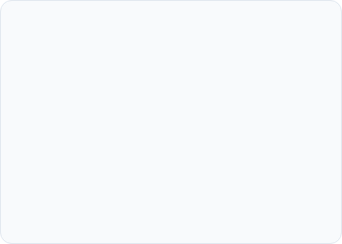
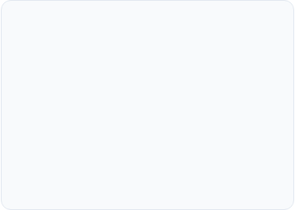
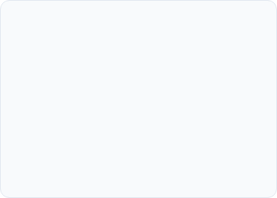


Key Platform Features
Public Interface
Dashboard Security
Single "Buy Now"
Intentionally thin public layer providing lookup capability. Minimal friction directory lists active shops alongside single item previews by ID.
An authenticated zone allowing staff to create, edit, or delete store assets safely. All database updates enforce token checks.
Instantaneous purchasing pathway with no shopping cart. Clicking buy immediately creates the order and updates inventory states.
03 / 10

Slide 4


Modern Technical Stack
BACKEND CORE
FRONTEND INTERFACE
High Performance API
Robust User Experience
The backend runs natively on Bun, bypassing complex bundlers and allowing direct TypeScript execution.
The user interface is decoupled and built leveraging next-generation React paradigms.
Express 5 handles REST routing seamlessly.
Next.js 16 (App Router) & React 19.
Apollo GraphQL 5 powers dynamic queries.
React Compiler optimized builds.
Mongoose 8 & MongoDB map the schemas.
Tailwind CSS 4 for utility-first layouts.
Passport.js manages credentialed sessions.
Standard credentialed cookies (SameSite=Lax).
04 / 10

Slide 5

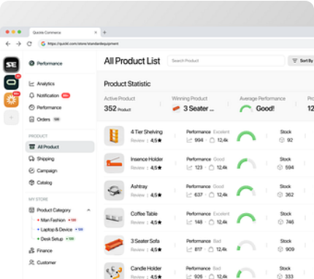
Frictionless "Buy Now" Checkout
SINGLE ITEM SALES PATTERN
Ultra Thin Transaction Layer
Kiyas replaces the classic shopping cart framework with a direct single-item check-out method, ensuring speed and clarity for small vendor environments.
Direct user purchase directly from an item detail layout.
Instant stock reduction on backend transaction success.
Immediate logging into user personal purchase timeline.
05 / 10

Slide 6
Getting Started Guide
Environment Set up Copy the target sample backend configuration via cp backend/.env.example backend/.env. Configure the database connector DATABASE_URL and local session keys.
Initialize & Start Backend Run cd backend && bun install && bun run dev. The backend executes directly on Bun, bootstrapping the MongoDB connections on standard port 3000.
Initialize & Start Frontend Configure frontend/.env.local pointing to the core API URL, then trigger cd frontend && bun install && bun run dev -p 3001.
Access Application Surface Navigate directly to http://localhost:3001 to view the public shop directories and interface.
06 / 10

Slide 7


Seeding & Smoke Testing
Bootstrap Local Dev State
Puppeteer Automated Run
Since raw API security restricts default admin-level creation parameters, Kiyas provides a seeding helper script:
A full automated framework tests basic operations, user auth states, and edit transactions across the entire environment pipeline:
* Refuses execution safely whenever production environments are detected.
07 / 10

Slide 8

Known System Limitations
System Domain | Reported Limitation | Impact Level
Authentication | Password reset currently accepts plain text inputs with no link/token verification flows. | Medium
Database Operations | Admin 'delete item' query structure is routed incorrectly and actually deletes the whole shop. | High
Media Uploads | File status indicators do not refresh automatically when upload actions are finished. | Low
Backend Dependencies | Dead legacy Google OAuth code references remain in the underlying source. | Optimization
08 / 10

Slide 9
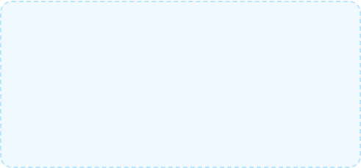
System Architecture Metrics
DATA SECURITY MODEL
100 %
Zero Cross shop Leakage
The backend queries explicitly enforce automatic scoping by shopId for all database queries and operations, ensuring no tenant metadata overlaps or escapes.
Tenant Isolation Scoping
Direct backend filters on MongoDB schemas.
Role-gated server mutations for admins.
09 / 10

Slide 10
Thank You
10 / 10

